Slide 1

What happens when you enter a Black Hole ?
Celia Kherfallah

Slide 2
Plan
Introduction
what are black holes?
what happens when you enter a black holes ?
Stephan Hawking and his discoveries
Conclusion

Slide 3
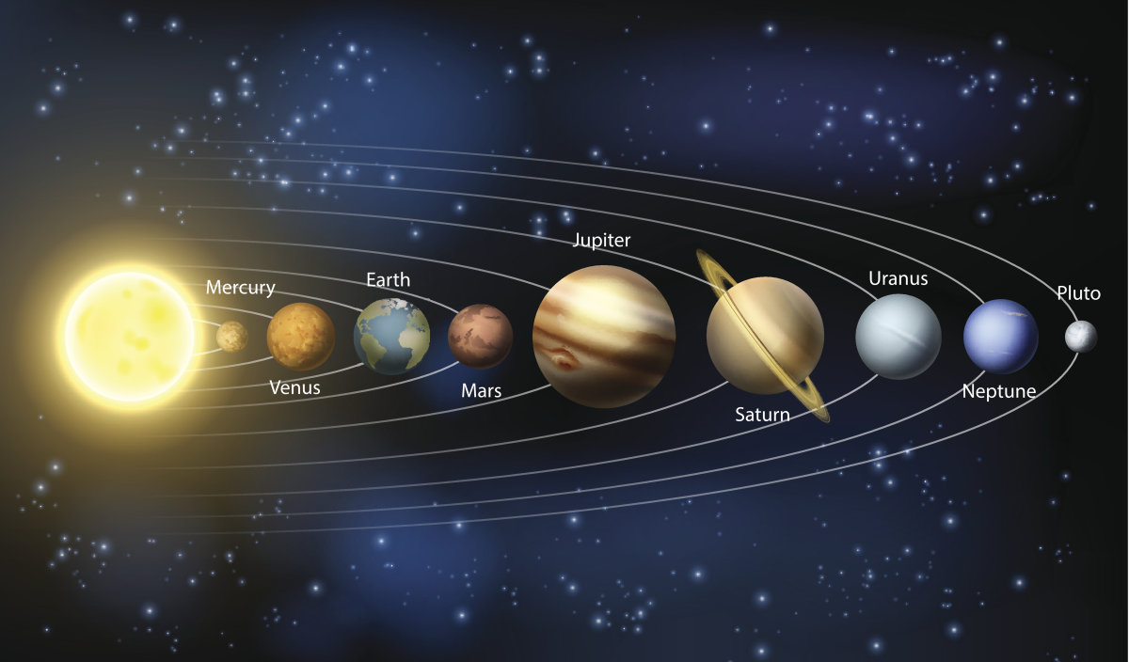
Introduction

Slide 4
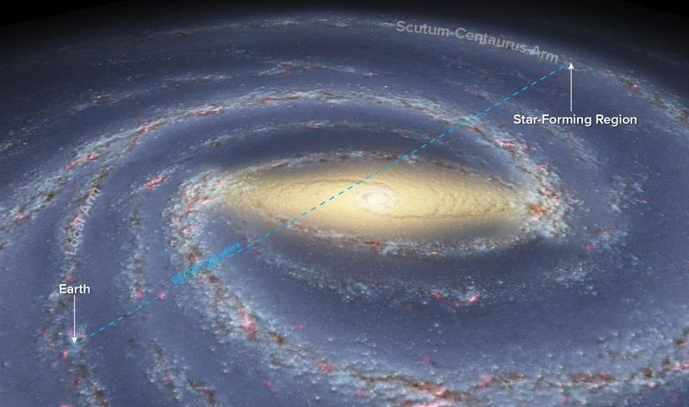
Introduction

Slide 5
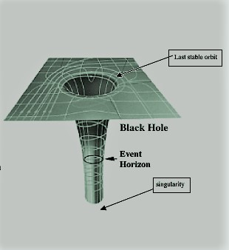
What are Black Holes ?

Slide 6
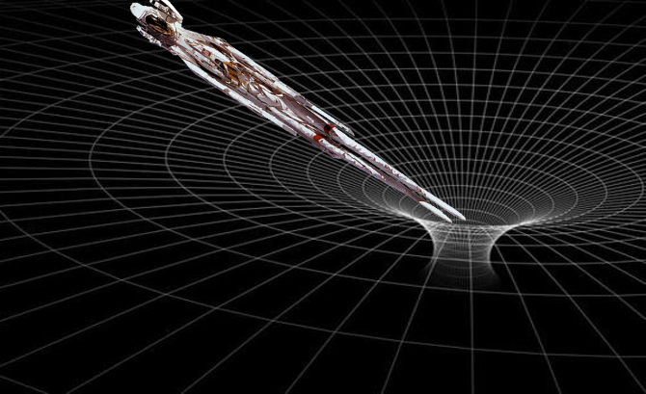
What happens when you get closer to a Black Hole?

Slide 7
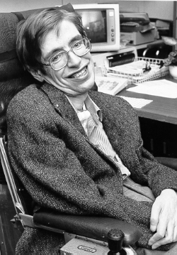
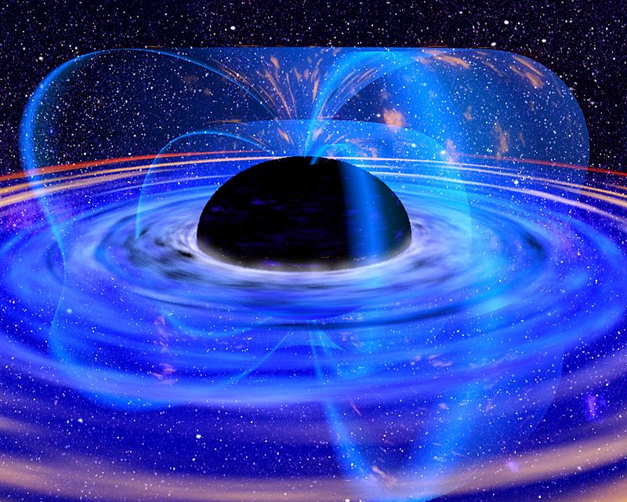
Stephan Hawking
Hawking radiation

Slide 8
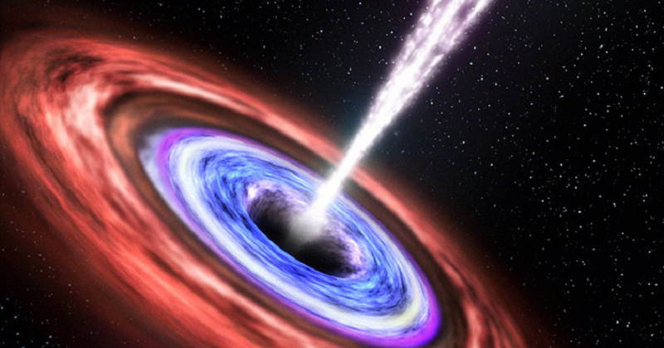
Conclusion

Slide 9
Thank you for listening
References :
-Observation of quantum Hawking radiation and its entanglement in an analogue black hole
-Thermodynamics of Black Holes in Anti-de Sitter Space

